Slide 1


Peninsula Harbour Port Authority Inc
Open House
Public Information Sessions
June 25 & 26, 2025
Town of Marathon
Biigtigong Nishnaabeg

Slide 2
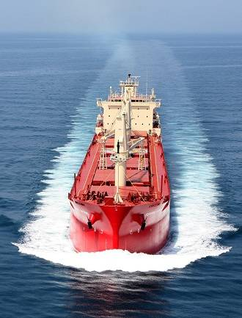
Presentation Outline
History of the Port
Peninsula Harbour Port Authority
Strategic Port Operating Partner
Existing Port Conditions
Marketing Plans
Infrastructure Improvement Plan
Dredging Plan
Economic Impacts
Tourism
Questions & Answers

Slide 3
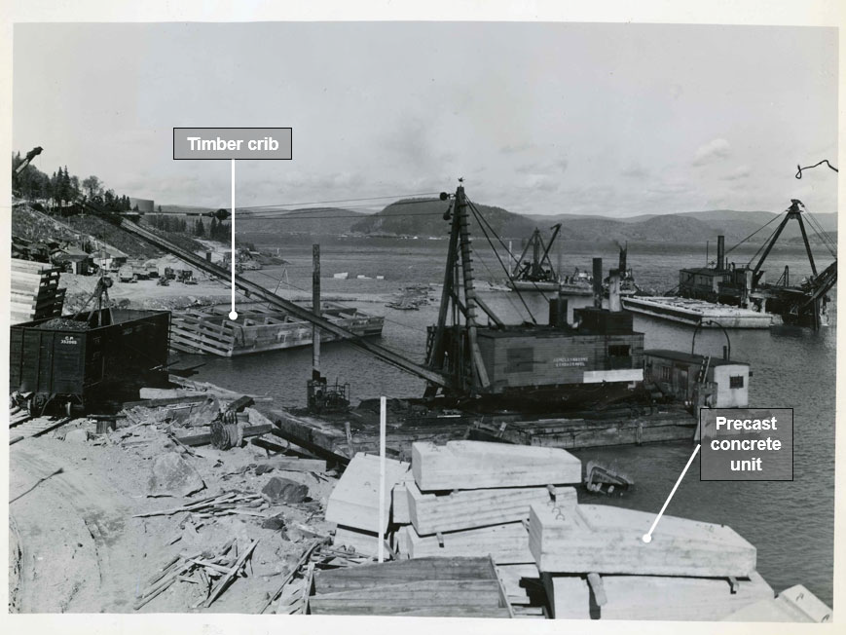
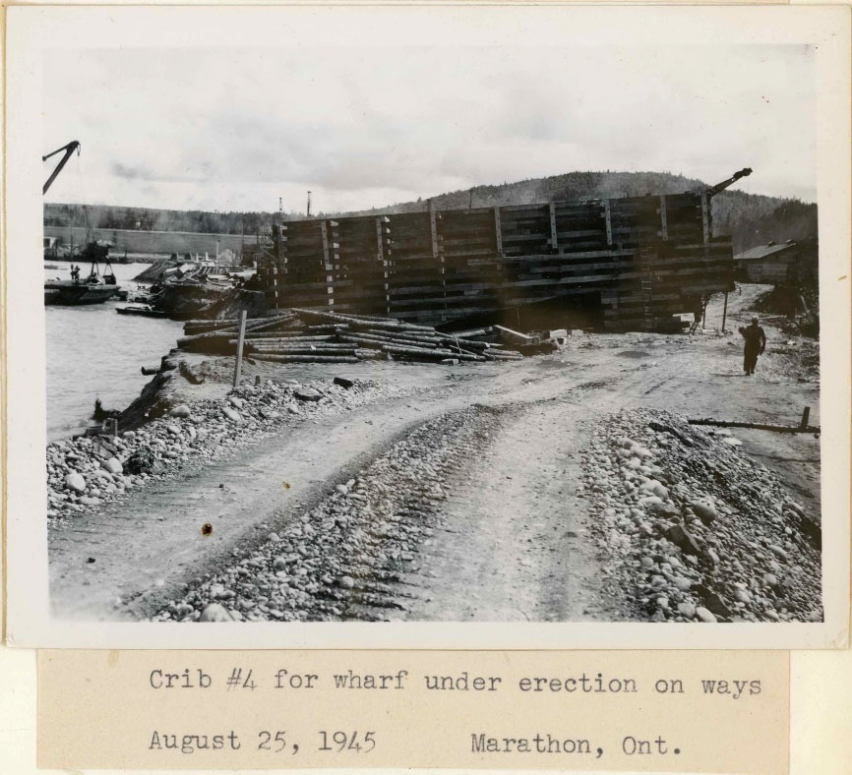
History of the Port
Vessels Servicing the Mill up to ~ 35,000 DWT
Coal, Limestone, Bunker C Fuel Oil
Used up to 2009 when Mill Operations were shut-down
Wharf originally constructed in 1945
Precast Concrete & Timber Crib System

Slide 4
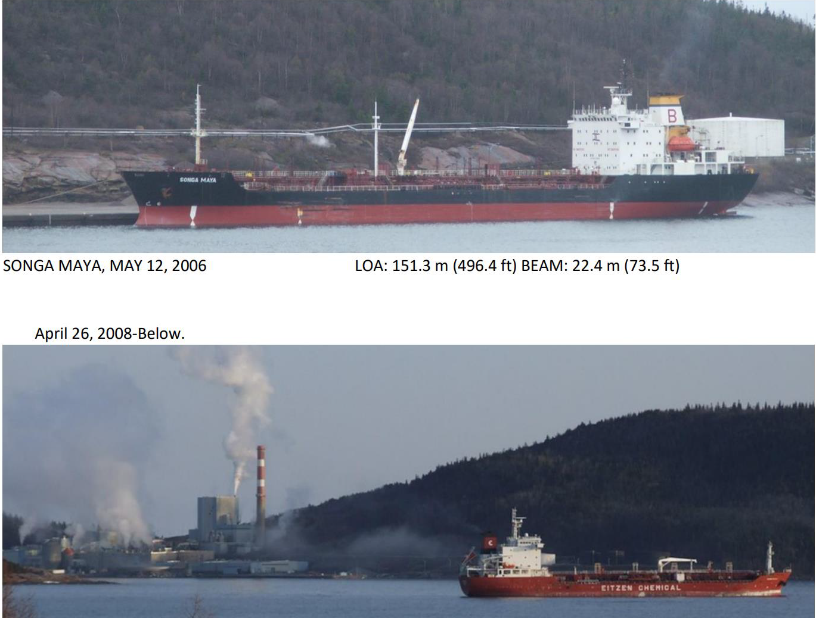

Slide 5
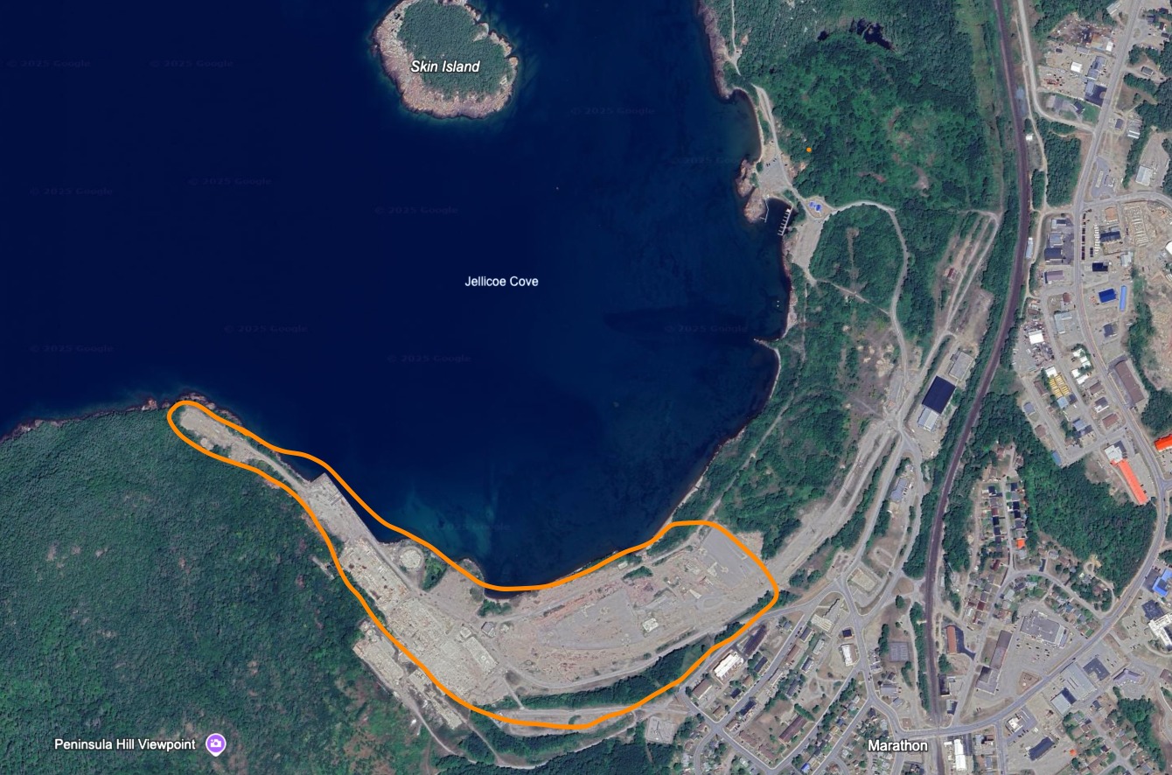
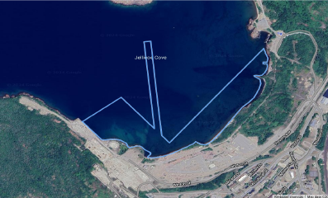
History of the Port
2011 Town of Marathon Assumed Ownership from Tembec as part of a larger package of former mill lands.
Town Owned ”Water Lots”
Approximately 100 acres of Heavy Industrial Zoned Land

Slide 6
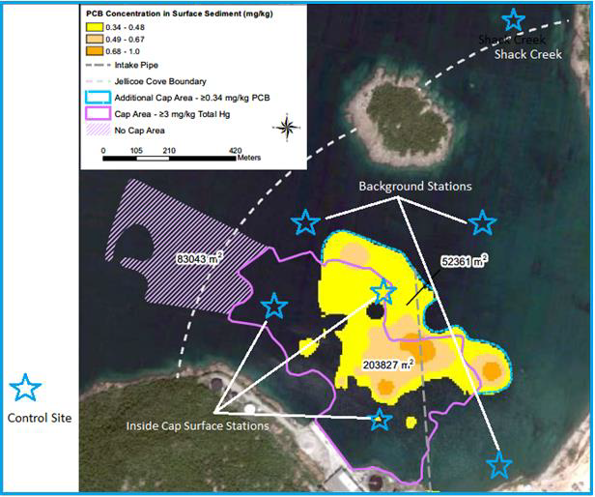
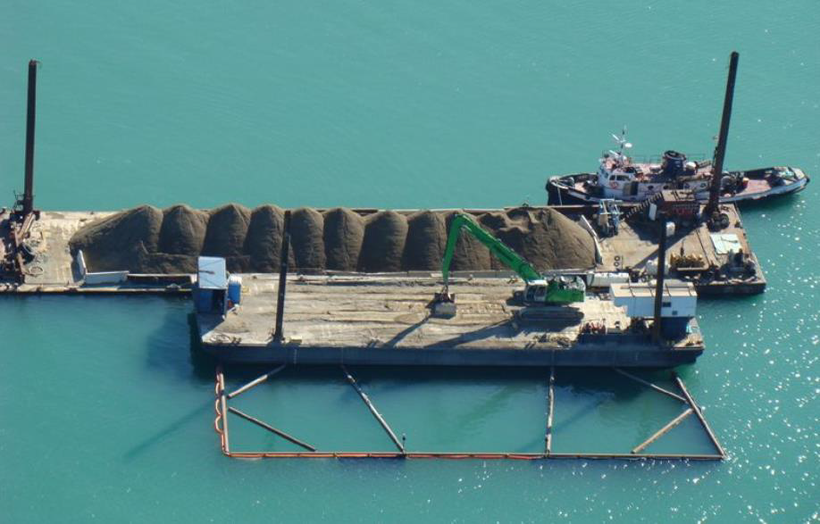
Jellicoe Cove Remedial Action Plan
Port was part of the Jellicoe Cove Remedial Action Plan in 2012
A ”thin layer cap” of sand and gravel was placed over historical mercury and PCB in the lakebed sediment.

Slide 7



Peninsula Harbour Port Authority
Incorporated in late 2020
50:50
Board of Directors
Daryl Skworchinski, CEO, Marathon
Mayor Rick Dumas, Director, Marathon
Chief Duncan Michano, Director, BN
Debi Bouchie, Director, BN
VISION = Create shared economic development and tourism opportunities for two communities together…through revitalizing a regionally important marine port into an international success story.

Slide 8

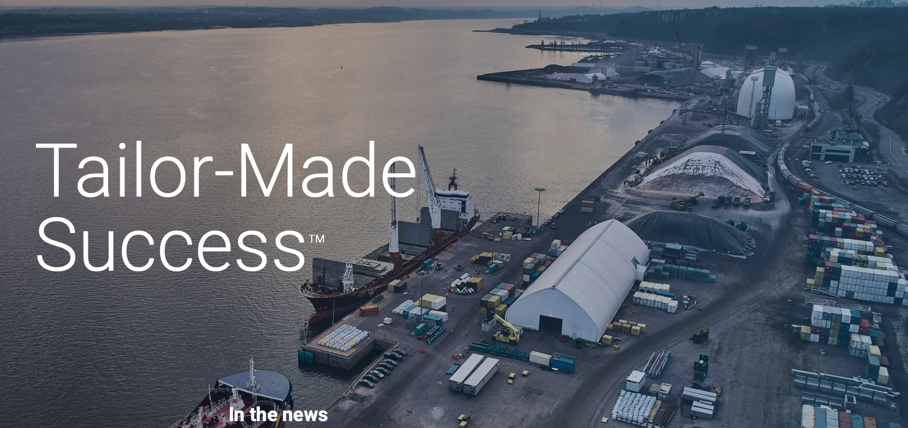
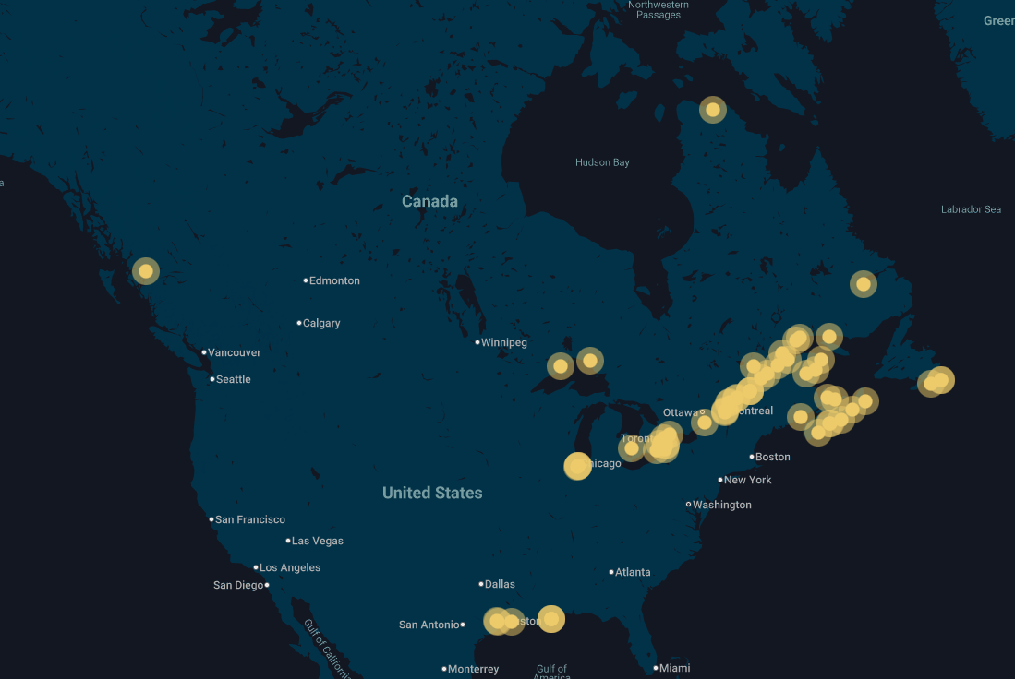
Strategic Port Operating Partner
Terminal Operating Agreement 2024
Global Marketing
Marine Engineering
Operations Support
Stevedoring, Logistics, Warehousing
Local Staff Recruitment, Training, Safety, Employment

Slide 9
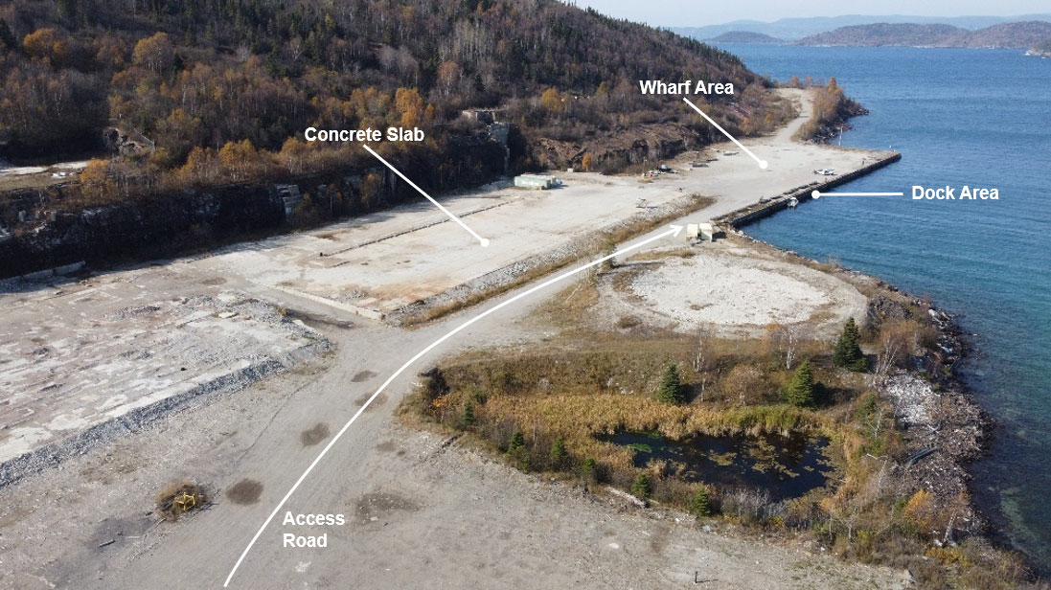
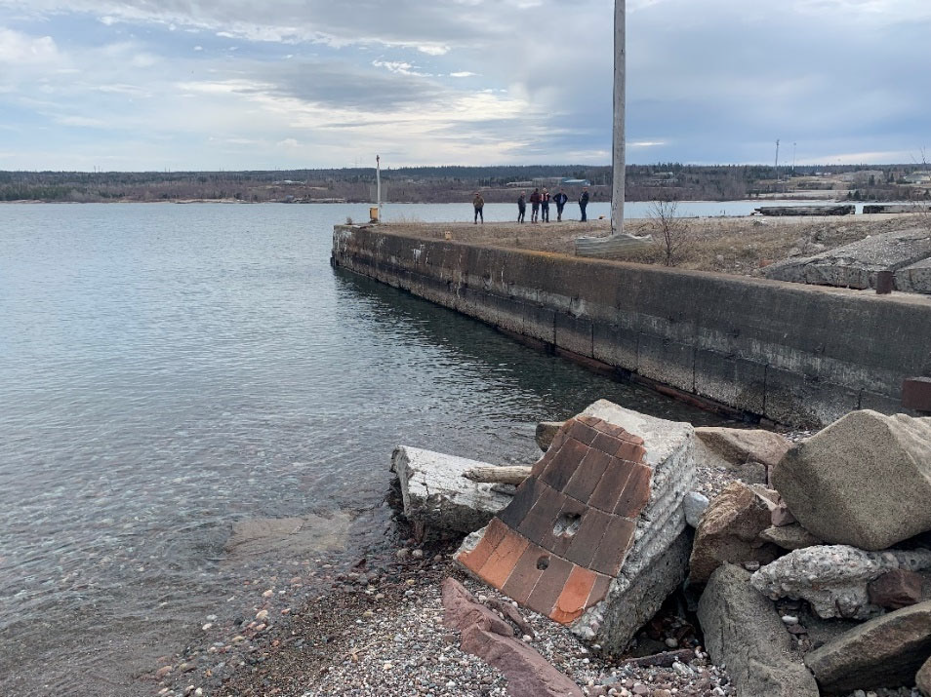
Existing Port Conditions
2010 and 2022 Engineering Assessments
Wharf and dock are structurally sound.
Site is excellent for operations and storage.

Slide 10
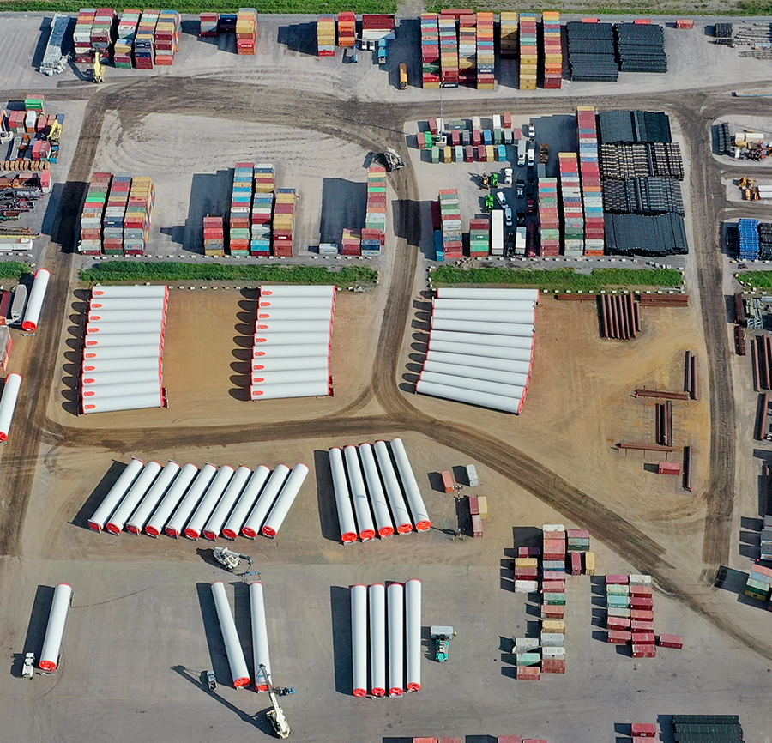
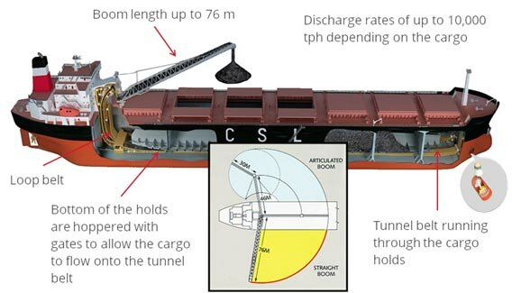
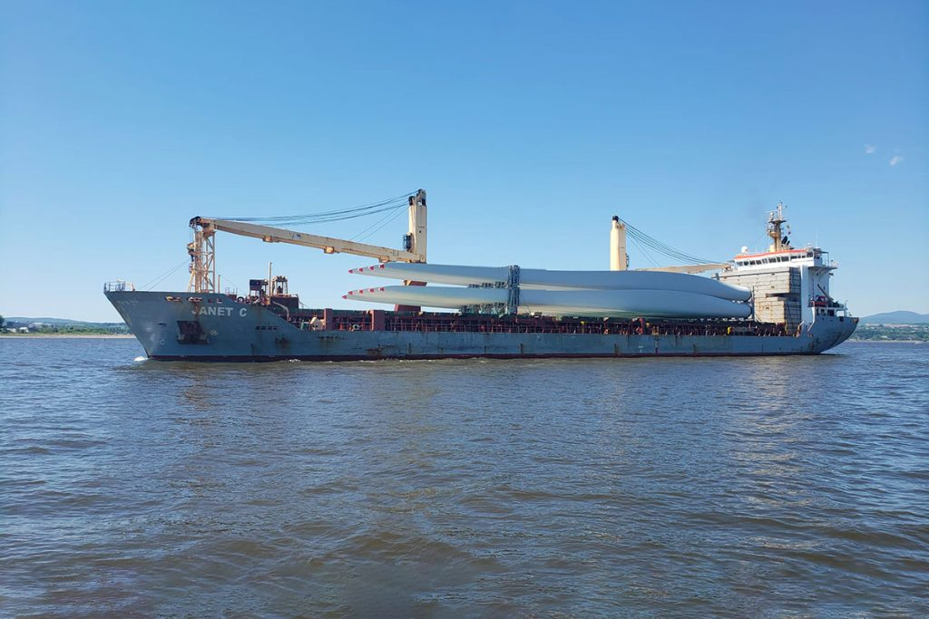
Marketing Plans
Advantages
Hwy 17 & CPKC Rail
Proximity to Mines, Forest Products, Renewable Energy Projects
No Area Competition
Deep Water Terminal
Skilled Local Labour
Marine Shipping is:
Most Efficient
Lowest Cost
Lowest Carbon Emissions
Environmentally Responsible
Forest Products (Pellets, Chips, Biomass, Lumber)
Road Salt, Aggregates, Cement
Renewable Energy Parts (Windmills)
Energy Transmission (Pipelines)
Mining Equipment, Ore, Concentrates

Slide 11
Infrastructure Improvement Plan
Project Work Item | Description
Detailed Engineering, Permitting, Approvals | Retain third-party engineering firms to complete assessment and design work for capital improvement plan items as required (structural, electrical, civil, environmental).
Civil Improvements | Construct/Improve existing, on-site roads, grading of yard, drainage improvements (ditching, stormwater management).
Dredging Jellicoe Cove | Removal of approximately 35,200 m³ of sediment, phase separation (solids and effluent), effluent treatment and discharge, sediment solidification, sediment (solids) transport and disposal at Town of Marathon Landfill Site.
Electrical Sub-Station Rehabilitation & Upgrade | Restarting existing sub-station, construction of an alimentation site (600v plug), service for future warehouse, tower lights, camera (security systems).
Scale System Upgrades & Commissioning | Relocate existing Town of Marathon Scale House and System from former mill site to wharf entrance area, scale calibration and certification, commissioning.
Dock Rehabilitation | Repair of existing dock structure including adding concrete/grout to sinkholes and gaps, repair of timber cribbing and bollards, grading/paving dock area, dock drainage systems, installation of steel protection plates etc.
Supply & Install New Fuel Storage Systems | Install new TSSA certified bulk fuel storage tanks and pumps to fuel on-site heavy equipment.
Concrete Slab Rehabilitation and Paving | Restoration, scarification and pouring of concrete to repair existing 134m x 56m concrete pad for use as a material handling and storage pad (interim) and future 100m x 40 m warehouse facility.

Slide 12
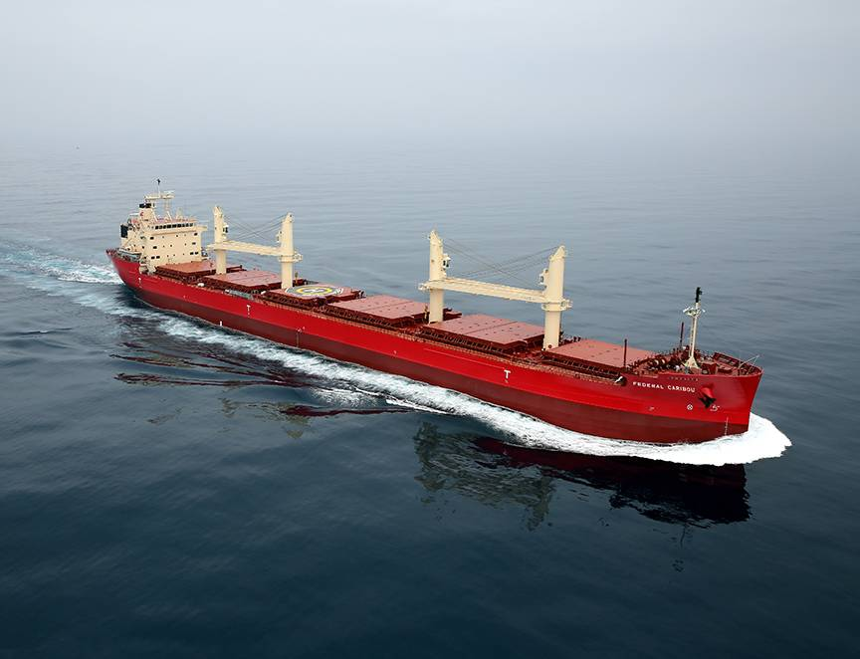
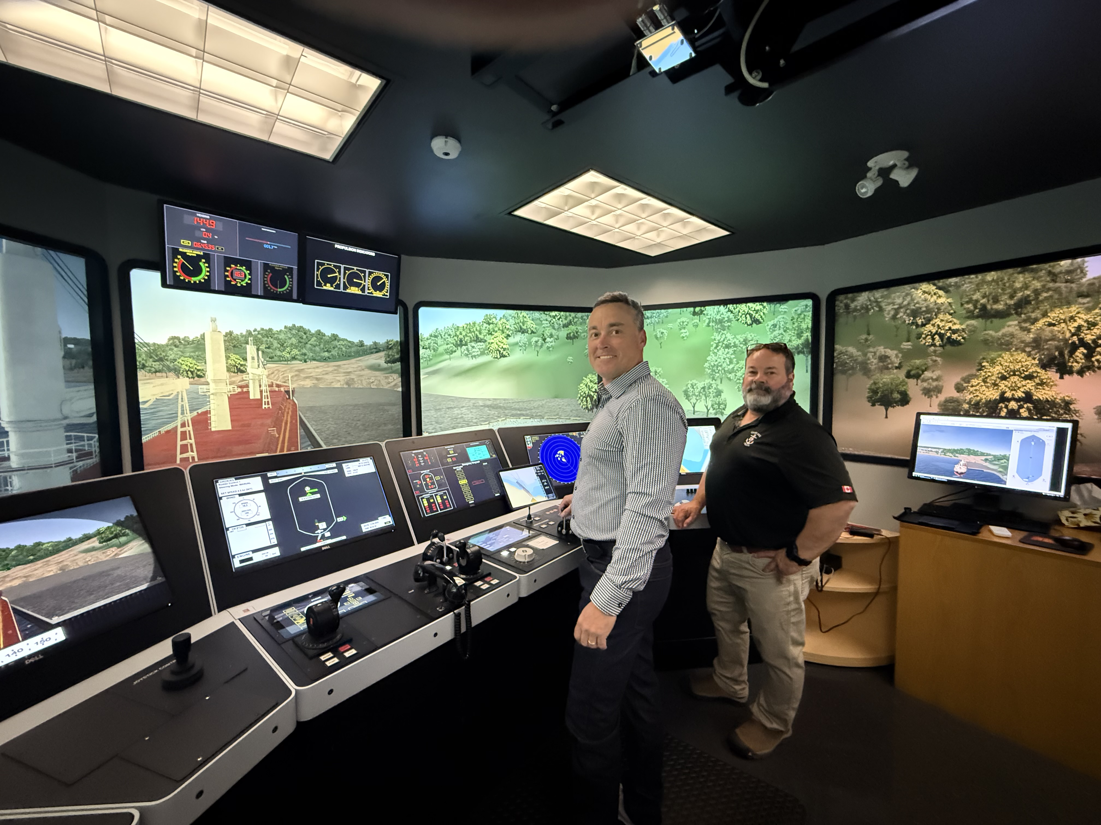
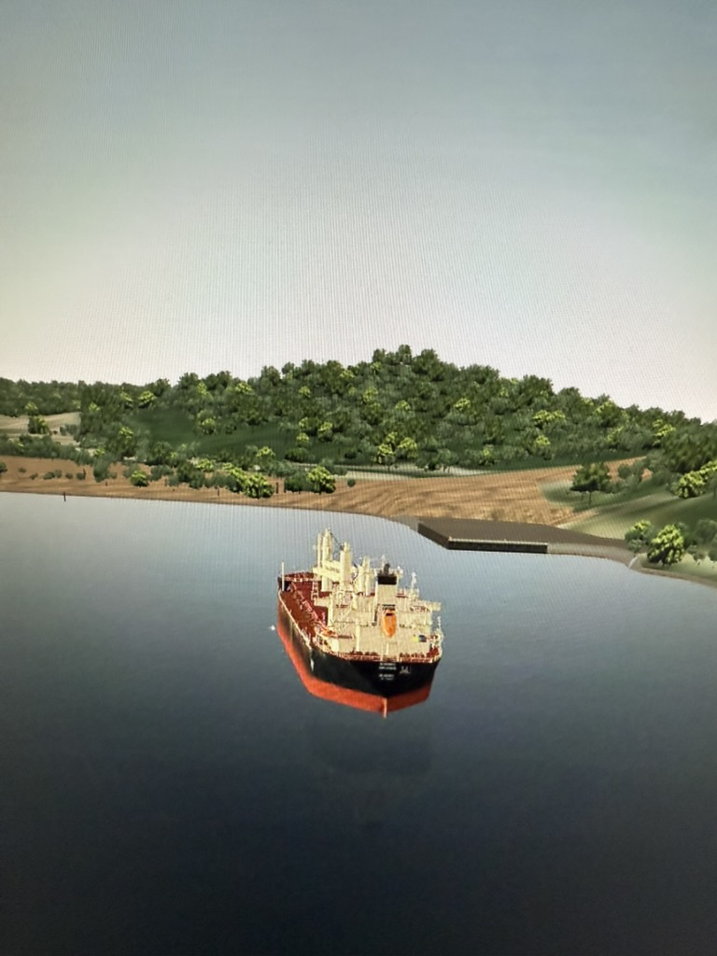
Maneuvering Simulation Study

Slide 13
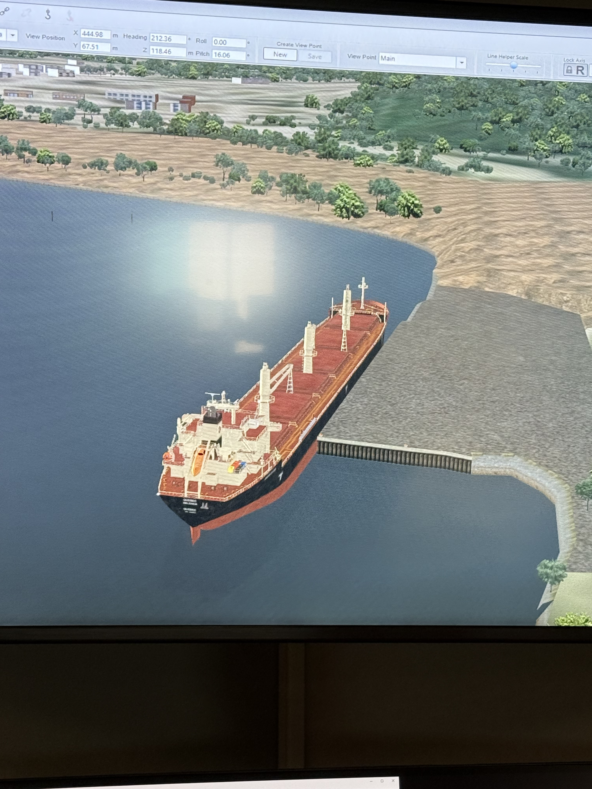
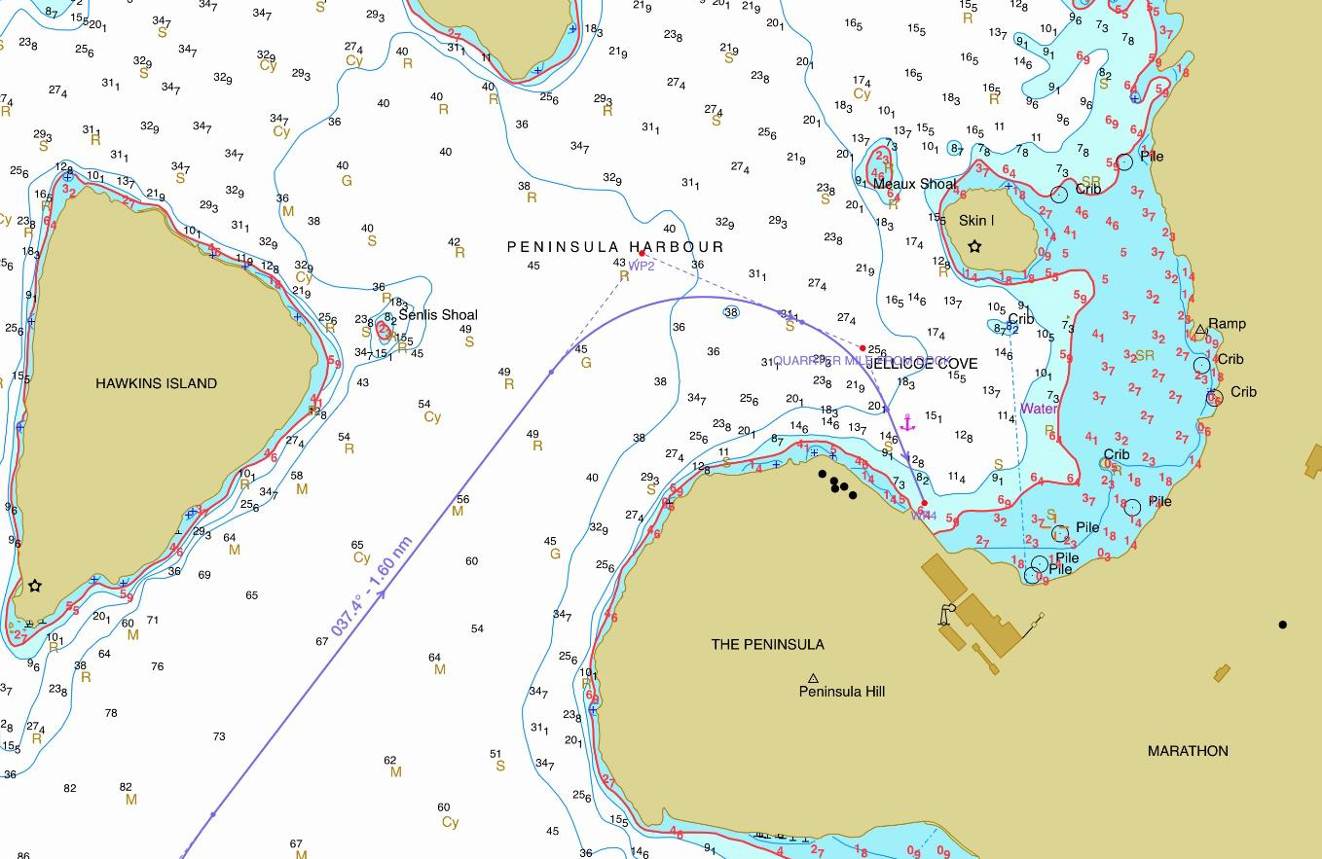
Simulations
IMG_0023.MOV

Slide 14
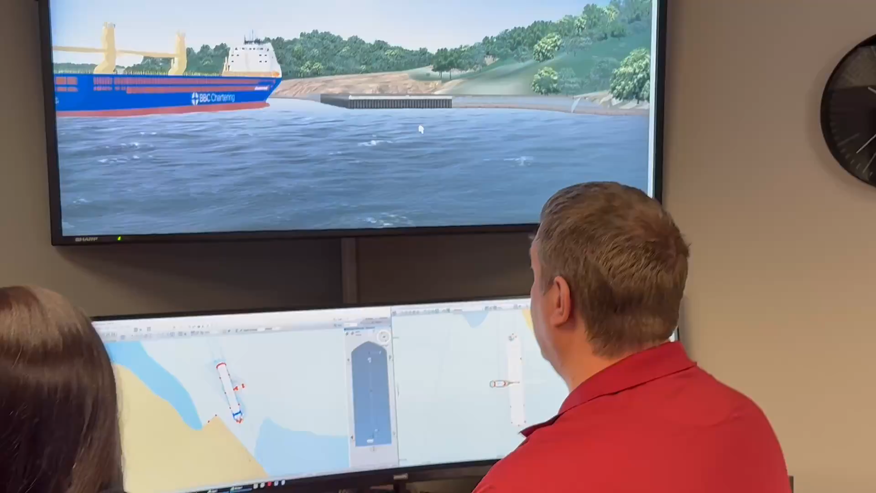

Slide 15
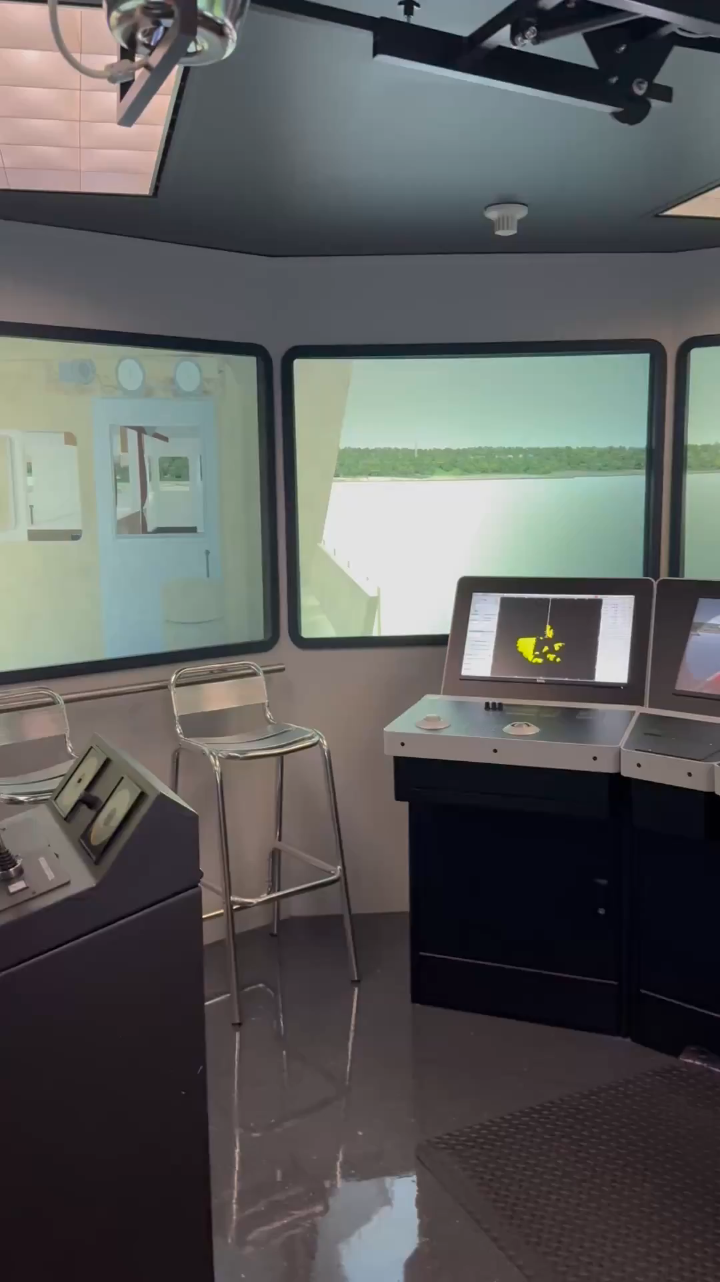

Slide 16
Dredging Plan

Slide 17
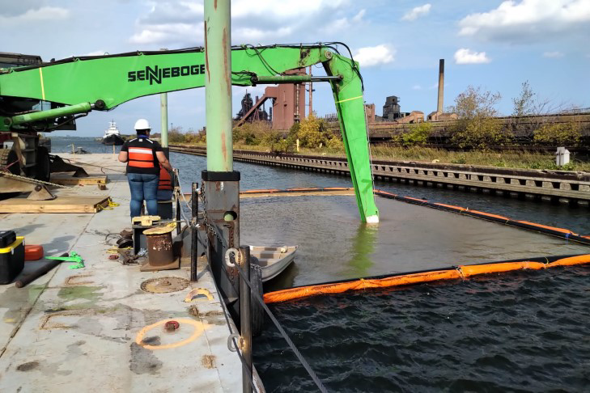
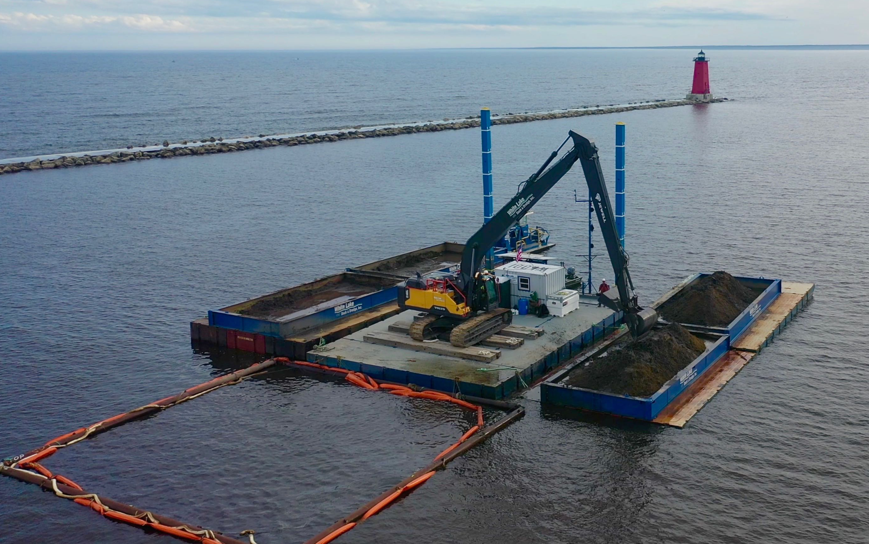
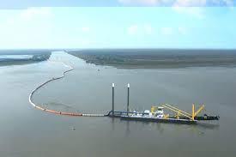
Dredging Plan
Notice of Project Issued to MNR April 15, 2025
Initiates the formal Permitting/Approvals Process
  Approximate Schedule is 12 Months to Complete
Sediment Removed from Lake, Separated, Treated, Disposed

Slide 18
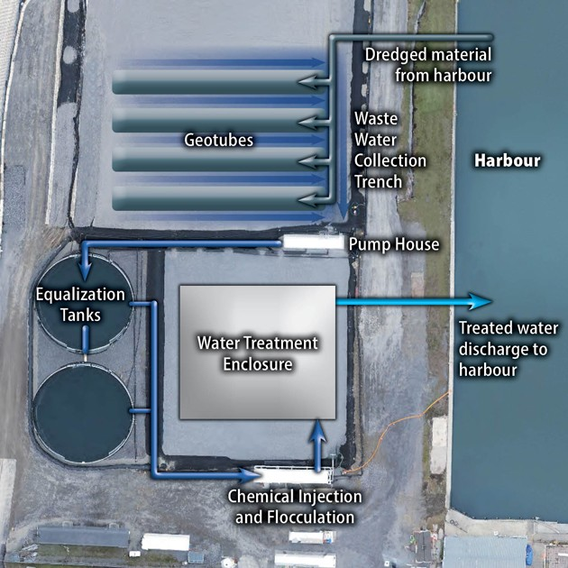
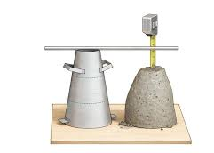
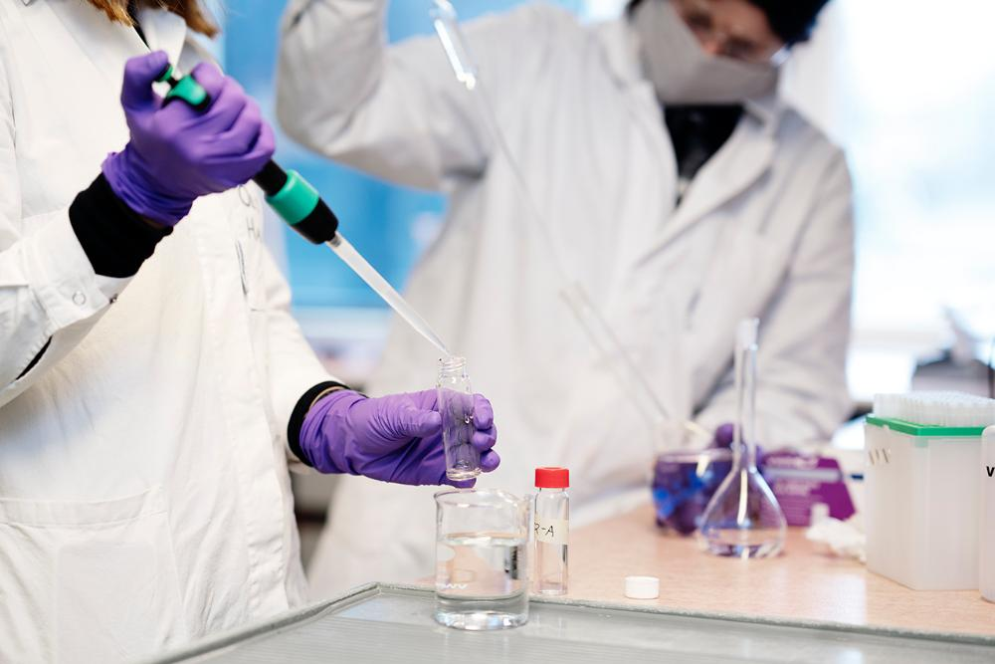
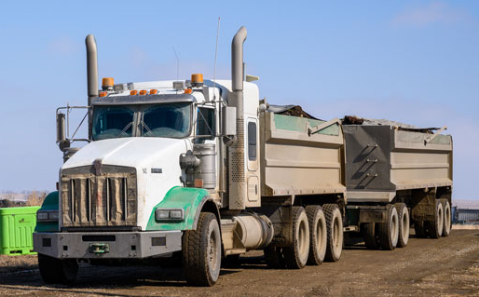

Dredged Sediment Treatment & Disposal
Water and Sediment Separation & Treatment
Solidification Testing
Chemical Testing
Solids to Camp 19 Landfill (Cover)
Water Meeting Ontario Water Quality Objectives back to Lake Superior

Slide 19
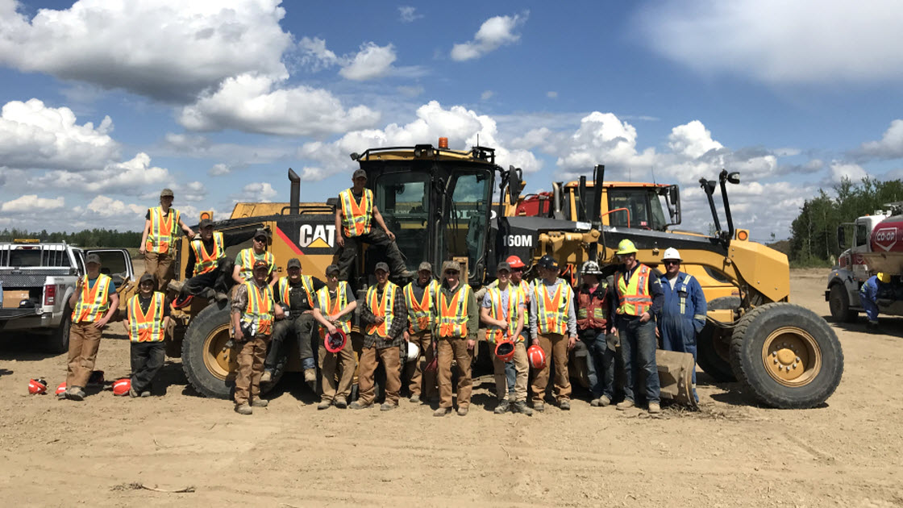
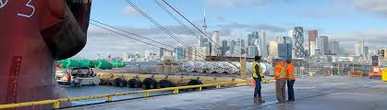
Economic Impacts
Construction
~ 150 FT Jobs Over a 2 Year Period (Approximately)
Operations
~ 22 Direct New FT Jobs at Port
~ Up to 50 In-Direct New Jobs Created In Communities
~ 3-5M per Year In Direct Spending in Marathon Area Labour/Service/Supply Chain
Indigenous Business Partner Opportunities
Direct and In-Direct Full Time Employment (BN Owned Companies)
Transportation (Trucking) Jobs
Heavy Equipment Operations
Skills Development and Training (Stevedoring, Equipment Ops etc.)

Slide 20
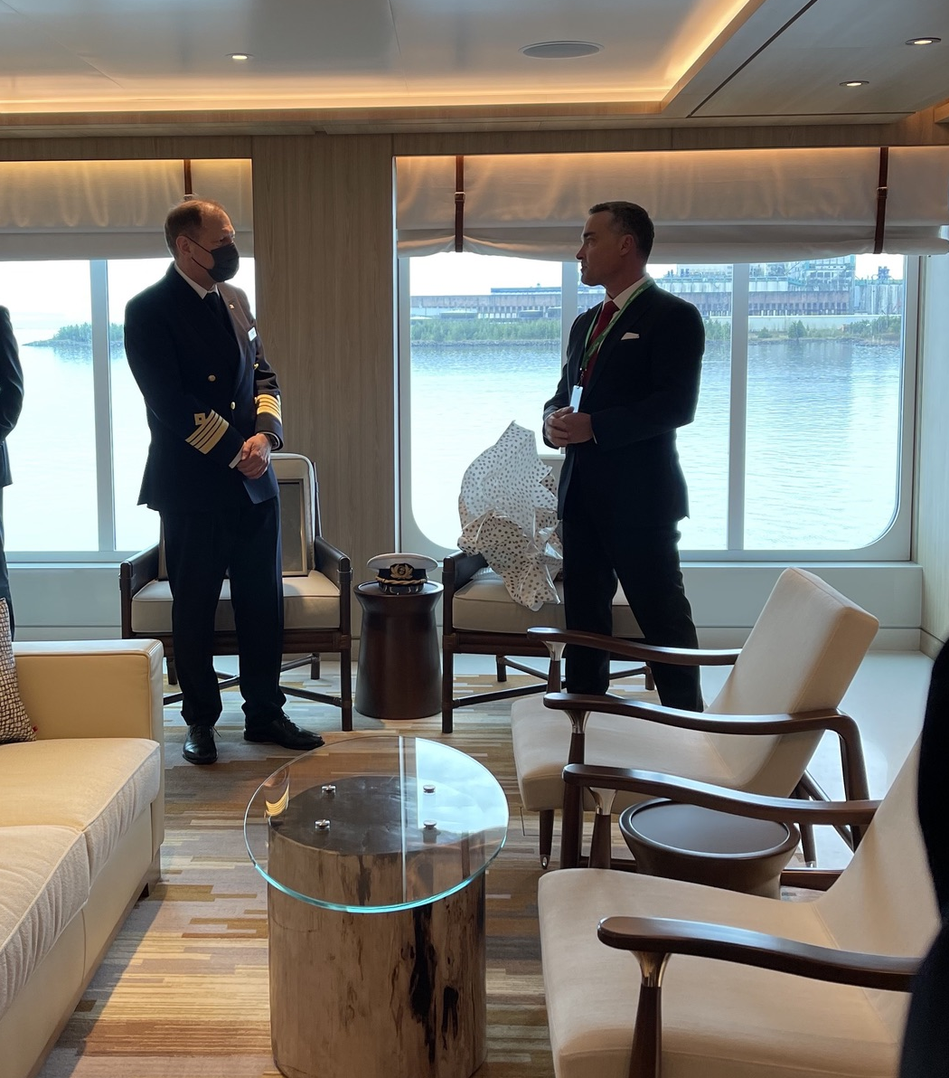
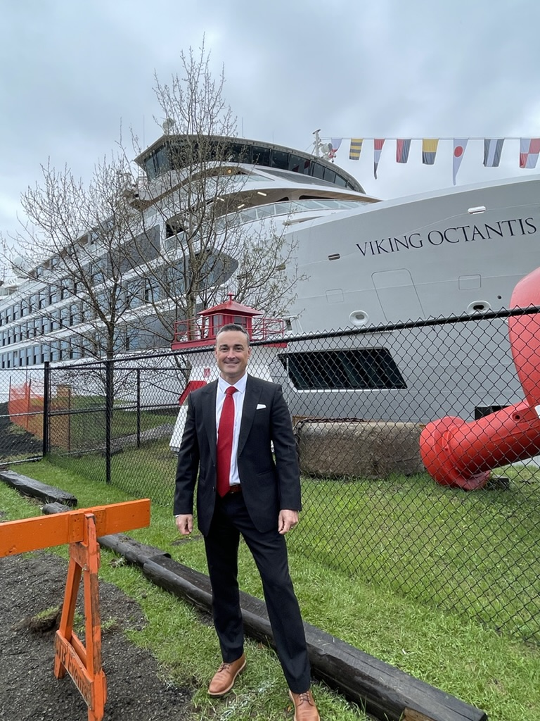
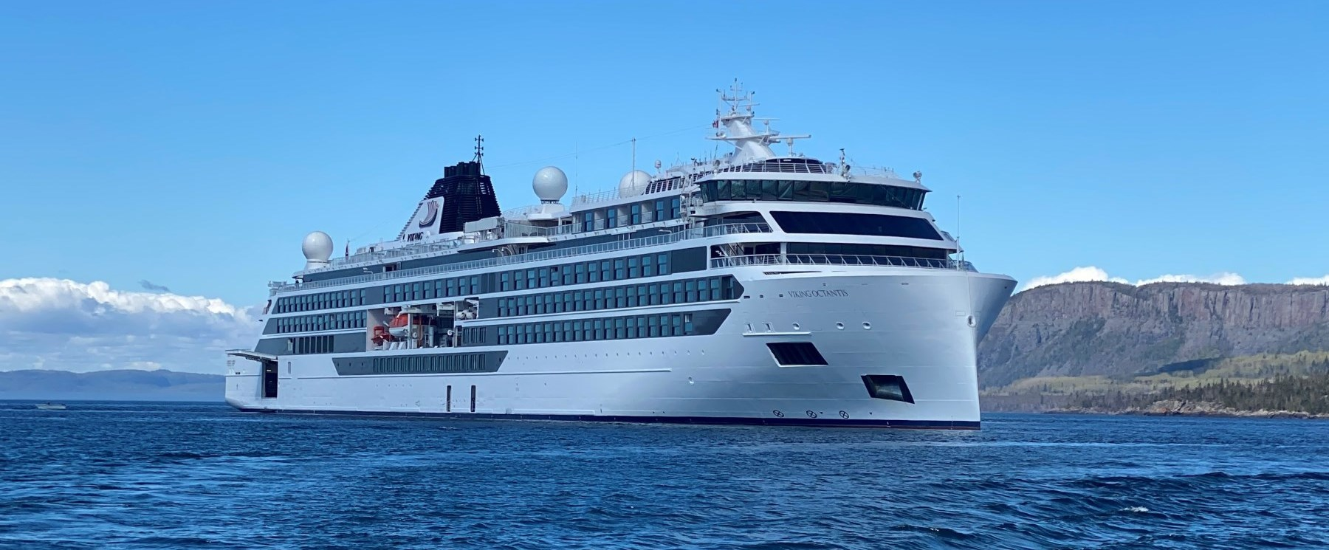
Tourism
Cruise Tourism is Booming on the Great Lakes
Indigenous Tourism is Growing
New Product Development Ideas….
Guided Tours of Pukaskwa Park, Indigenous Waypoints, Shorelines
Interpretive Elder Tours of Local Culture & Heritage, Art
Healing Lodge Experiences
Local Marathon Attractions
(Pebble Beach, Penn Lake Park, Golf Course, Carden Cove, ALC…)

Slide 21

Questions & Answers
This Photo by Unknown Author is licensed under CC BY-NC-ND

